Slide 1


Durham Government Open Data Partnership
Greg Marrow
Chief Information Officer
Durham County Government
Kerry Goode
Chief Information Officer
City of Durham
Jason Hare
Project Leader and Open Data Consultant

Slide 2


Agenda
City/County of Durham Overview
Vision for Open Data
Project Flow and Status

Slide 3
City/County of Durham Overview
Greg Marrow
Chief Information Officer
Durham County

Slide 4
Insert open data trivia

Slide 5
History of Partnership
Joint
GIS
Inspections/Permits
Planning
Taxes
City
Community Development
Street maintenance
Police
County
Schools
Sherriff
DHHS

Slide 6

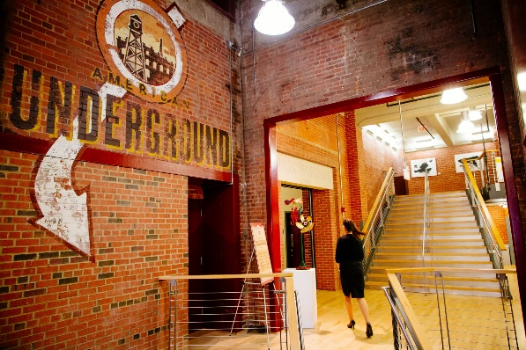

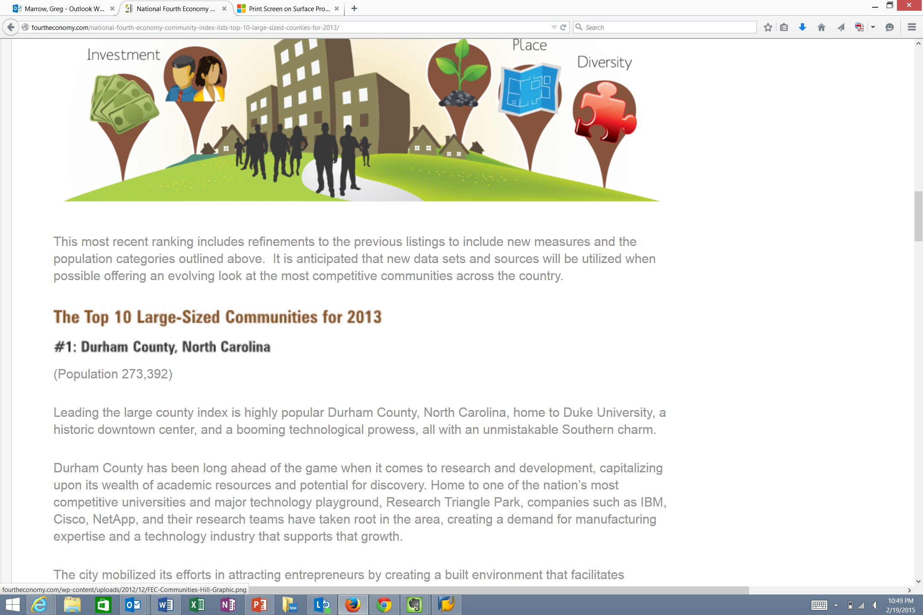

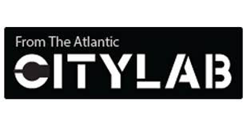
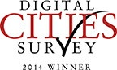
Durham Region is on Fire!
Durham – 1 of 7 Tech Hubs
#1 creative class metro by Atlantic Monthly
Notes:
Google recognized Durham has one of the seven key tech hubs in the United States-2013
The American Underground, home to more than 100 startups at two locations in Durham, is among seven “tech hubs” in the United States and Canada selected for a new entrepreneurial support program run by technology behemoth Google. Read more here: http://www.newsobserver.com/2013/09/25/3227771/google-tabs-durhams-american-underground.html#storylink=cpy
High tech and traditional manufacturing are on the rise, with an additional 1,200 jobs announced in 2013.
Durham County, North Carolina Ranks #1:
Fourth Economy Community Index Lists Top 10 Large-Sized Counties for 2013
Fourth Economy Consulting has launched a new index, listing top counties from across the nation. The Fourth Economy Index highlights those communities ideally positioned to attract modern investment and managed economic growth within the fourth economy. The Fourth Economy Index highlights those communities ideally positioned to attract modern investment and managed economic growth within the fourth economy. …
In January 2013, Durham's food scene was again catapulted into the national spotlight by inclusion on Southern Living magazine's "Top 10 Tastiest Towns in the South." It shared company with culinary megastar destinations like New Orleans, Charleston, and Miami. The winner was chosen by popular vote through an online poll. Despite the difference in size between Durham and many of its competitors, the Bull City took home the title.
CityLab is dedicated to the people who are creating the cities of the future—and those who want to live there. Through sharp analysis, original reporting, and visual storytelling, our coverage focuses on the biggest ideas and most pressing issues facing the world’s metro areas and neighborhoods.
Digital Cities -- The City of Durham has been nationally recognized yet again for its use of technology to improve transparency with residents and operate more efficiently with taxpayer dollars. e.Republic’s Center for Digital Government and the Digital Communities Program announced the top-ranked cities in the 2014 Digital Cities Survey. Durham tied with the City of Hampton, Va. for fourth place in the 125,000–249,999 population category. In its 14th year, the annual survey is a part of the Digital Communities Program and is open to all U.S. cities. The survey criteria focused on results achieved by cities–via the use of technology–in operating efficiencies, realizing strategic objectives, innovative or creative solutions or approaches, effective collaboration and transparency measures, among others.

Slide 7

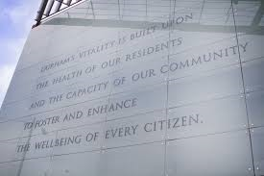


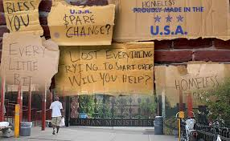

Durham City and County: Unique Challenges
How Can Open Data Help?
Safety
Health
Poverty
Education

Slide 8
Durham Partnership: What Makes this Different?
Leverages Partnership to take advantage of City and County common strengths and single community brand
Community Focused
The Platform, Datasets are chosen with usability, return of results and open/regional scalability.
Open Data: Open to Everyone!

Slide 9
City/County Open Data Vision
Kerry Goode
Chief Information Officer
City of Durham

Slide 10
Durham City & County CIOs Believe
Government is ideally positioned to extract value from open data and to help others do the same
Government has a critical role in unleashing the potential of open data.
Open data provides an opportunity to uniquely collaborate on community based challenges with insights provided by data as discovered by the community of stakeholders.
Open data value also includes new or increased revenue, savings, and economic surplus that flow from the insights provided by data

Slide 11
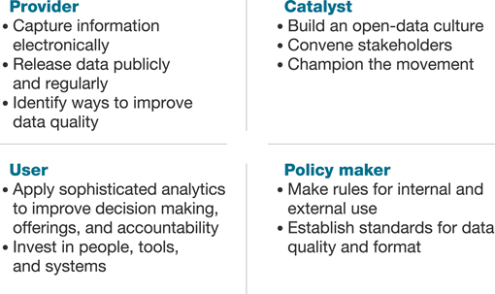
Durham City & County Government Roles
http://www.mckinsey.com/insights/public_sector/how_government_can_promote_open_data

Slide 12
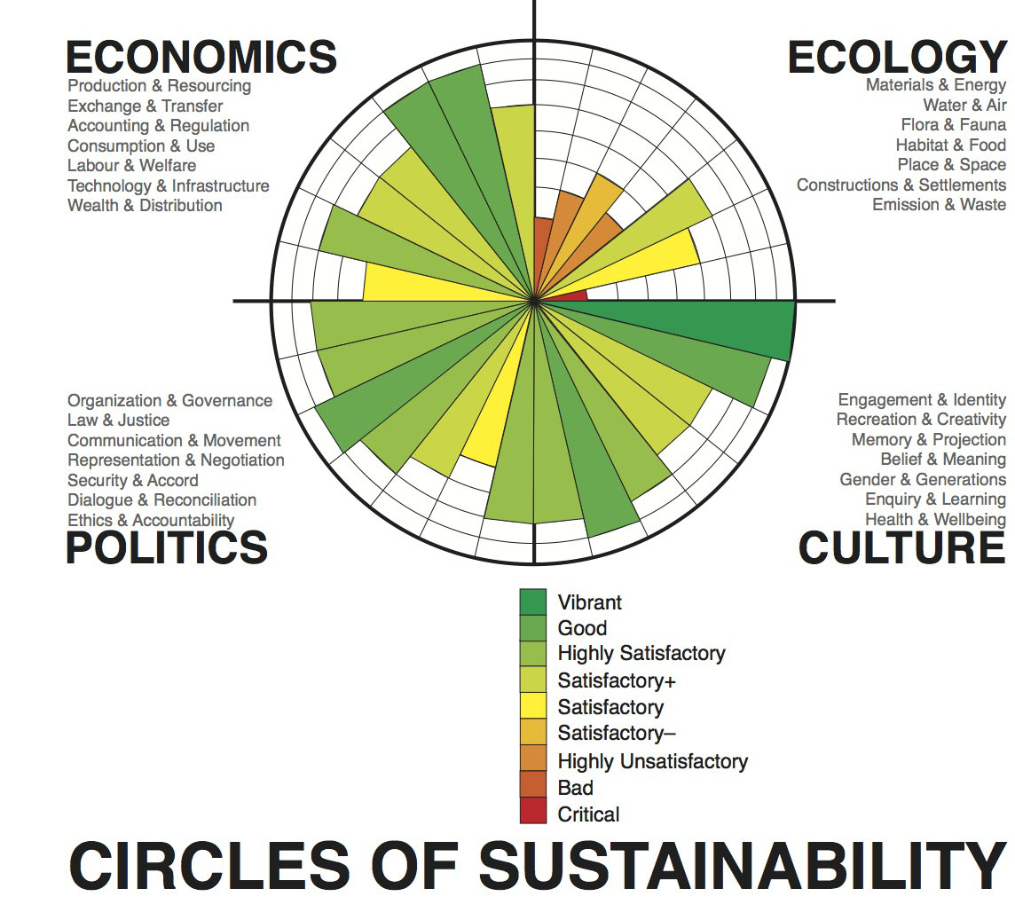

Slide 13
Open Data is an Enabler
The community can use open data to gain valuable insight into addressing social sustainability challenges in Durham in the areas of:
Economics
Ecology
Culture
Politics

Slide 14
Durham Story
Open data initiative origin came from grass roots
Code for America and government discussions
Joint CIO collaboration
City/County Strategic Plans alignment
Joint funding by City/County
Selling proof of concept to City/County governing officials to gain funding for initiative

Slide 15
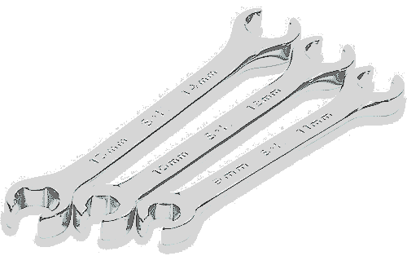
Durham’s Open Data Strategy
Build a world class open data platform
Excellent Usability
Utilized data sets
Facilitate empowerment and engagement with the open data platform
Proof of concept that effectively builds Social Sustainability value as primary focus
Notes:
Open data is not an end unto itself. Open data is a tool. A better metaphor is open data is a tool box to accomplish many things. The most important are not necessarily related to “transparency”. Sustainability is a practical approach to maximizing the use of open government data. There are several kinds of stability:
Economic sustainability: Open data initiatives that lead to pre-determined business outcomes and direct economic benefit to citizens, private sector and government.
Environmental sustainability: Open data initiatives that can lead to data based decision making on the part of citizens, the private sector and government.
Social sustainability: Using open data to solve issues of inequality, law and order, poverty, the allocation of resources in a crisis.
Open data are good…some are better. Learn how we know the difference and what we can do about it. Open data is really about re-use. The more re-use, the better the data.

Slide 16
City/County Open Data Project Flow
Jason Hare
Project Leader and Open Data Consultant

Slide 17
Open Data is an Enabler
Government plays a critical role to help enable value creation, manage risks, and engage stakeholders in open data. This is necessarily a public/private partnership. Our company understands how to motivate public sector customers.
Why does Government Care?
Enable value creation
Promoting better decision making
Stimulating development of new products and services
Increasing transparency and improving accountability
Manage risks
Protecting the privacy, security, and personal safety of individuals
Helping organizations manage risks related to confidentiality, liability, and intellectual property
Engage stakeholders
Engaging consumers/citizens, businesses, the media, and nongovernmental organizations in open-data efforts

Slide 18
Open Data Implementation Phases
Re-use Strategies
Deploy
Assess and Train

Slide 19
Open Data Implementation Phases
Phase I: Assess
Set up ongoing training and accreditation of staff and data sets according to the principles and standards of The Open Data Institute.
Phase II: Deploy
Manage open government data efforts including coordinating data reuse through APIs, create public data products, repositories, work flows and visualizations.
Phase III: Create value through data re-use
Improve data quality and how data quality is measured
Ensure data is available, reliable, consistent, accessible, secure, and timely to support the mission and activities of the jurisdiction
Phase IV: Lessons Learned- retrospective- the virtuous circle

Slide 20
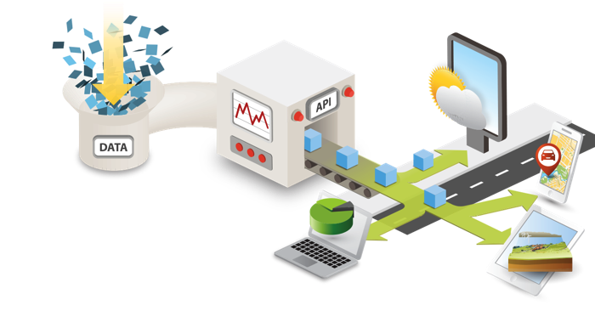
OpenDataSoft is a multi-cloud platform
API First

Slide 21
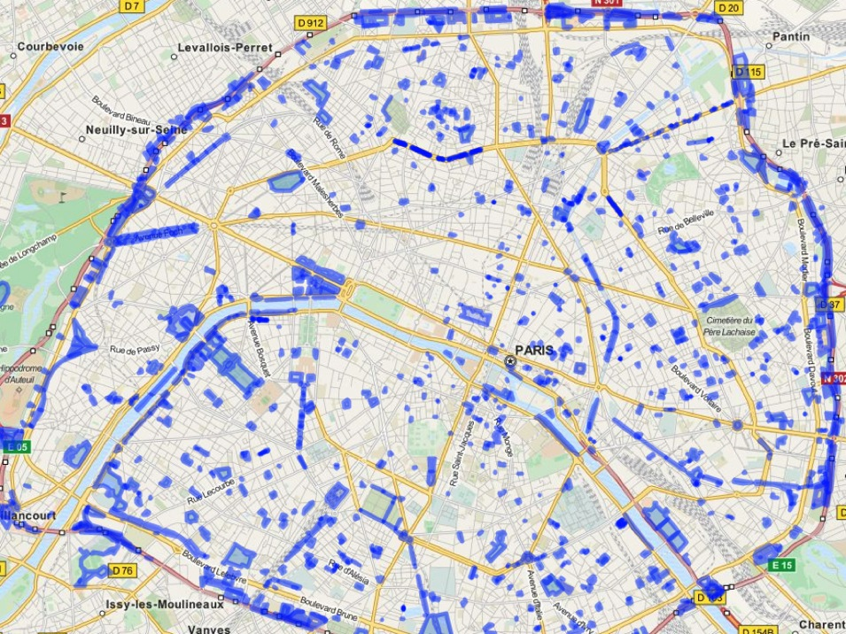











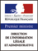

























They use OpenDataSoft…

Slide 22








Data Hubs
All data in one place for easier sharing with dedicated ecosystems (public administrations, transportation companies, utilities)
City Dashboards to monitor urban data through visualizations (maps, charts & graphs, galleries)
Fine-tuned security rules
APIs optimizing data reuse
Data Federation features (including data coming from Open Data portals powered by OpenDataSoft)

Slide 23
Early Thinking on Data Sets
Map data sets to strategic plan and intended business outcomes.
Increase confidence of residents in government
Data sets shared with intermediaries such as journalists, the faith community, the academic community

Slide 24

Convening a Community
Notes:
Open Data in Durham will involve residents both technical or not. We look forward to carry forward the idea of regionalism and creating a Triangle based data ecosystem. An opportunity for everyone to participate in open data.

Slide 25
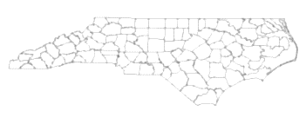
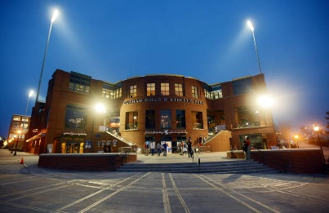
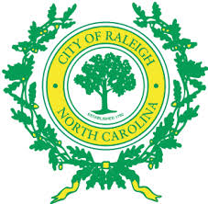


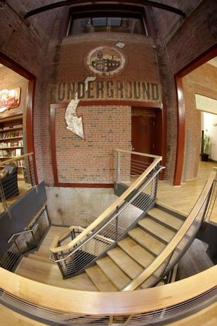


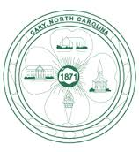
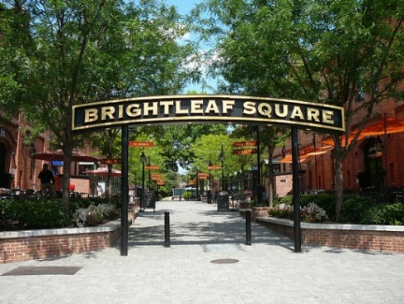

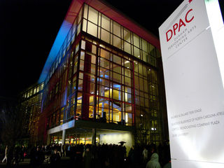

Thank You!

Slide 26
BLANK SLIDE

Slide 27
Footnotes and Credits
*AccessNC Dept of Commerce
http://fourtheconomy.com/national-fourth-economy-community-index-lists-top-10-large-sized-counties-for-2013/

Slide 28
Durham City and County: Unique Challenges
Durham Challenges – Example: Poverty/Education and Widening Gaps Between “Haves and Have Nots”
Durham is home to the world-renowned Research Triangle Park (RTP), home of more than 170 high tech companies, as well as a thriving entrepreneurial community.
Durham is distinguished by it’s high rate of educational attainment. In Durham County, 44.7% of adults over 25 years of age have obtained at least a bachelor’s degree.
Newsweek/Daily Beast #1 “Smartest City” and #2 “Brainiest City”
YET
Of the 53 schools in the Durham Public School system, all but seven received a C, D or F (Feb 2015)
Almost 65 percent of DPS students receive free or reduced lunch, a common poverty indication.
(not open data sets!)
Can Open Data be Utilized to Make a Difference in Solving the Gap?

Slide 29
Durham City and County: Unique Challenges
44.7% of adults over 25 years of age have obtained at least a bachelor’s degree

Slide 30


Durham Region is on Fire!
Combined population: one of fastest growing in North Carolina and in Nation.
1993: 196,000 2003: 237,000 2013: 288,000 2019: 314,600*
High tech and traditional manufacturing are on the rise, with an additional 1,200 jobs announced in 2013.
Exceptional economic, racial, cultural diversity: Drives an authentic “creative culture of artists, brewers, writers, restaurateurs and more bring yet another flavor of entrepreneurship.”
Google recognized Durham has one of the seven key tech hubs in the United States-2013
Durham County, North Carolina Ranks #1:
Fourth Economy Community Index Lists Top 10 Large-Sized Counties for 2013
“These communities are those ideally positioned to attract modern investment and managed economic growth.”
#1 creative class metro by Atlantic Monthly
#1 “Foodiest Town” by Bon Appetit

